Slide 1
[insert cool codename here]
Ames Bielenberg
David Saltzman

Slide 2
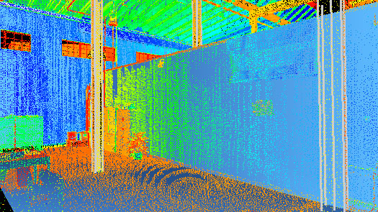

Overview
Accurate localization using external markers
Point cloud processing to create 3D map

Slide 3
Odometry error

Slide 4
Data matrix
ABC

Slide 5

Known marker positions

Slide 6
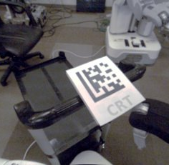
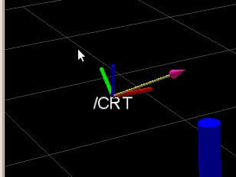
ROS datamatrix Package

Slide 7
EKF using external tags
kinect
frames
datamatrix
rel. xform
Map manager
robot pose
EKF
Known tag positions

Slide 8
Robot control
Robot controlled manually
A web-interface for driving/navigation
browser
rosbridge
JS
browser
ROS

Slide 9
Forming point clouds
Kinect gives us points with position and color
We can aggregate these into a point cloud.

Slide 10
Processing point clouds
Transform points to world frame
Cull excess and noisy data
Write data to file
Visualize data in web interface
  XB PointStream (WebGL)

Slide 11
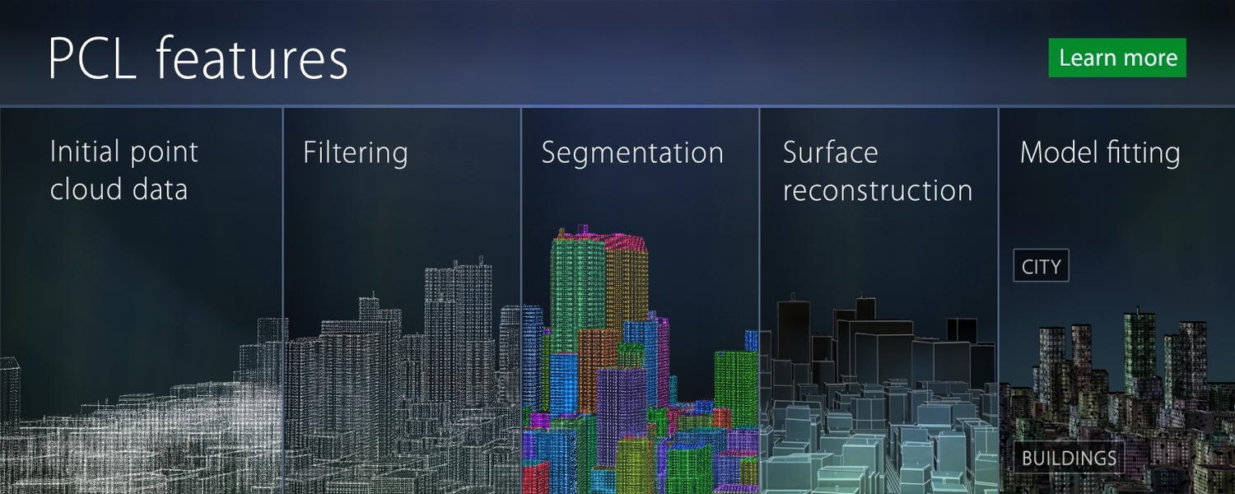
Point Cloud Library

Slide 12
references
http://www.ros.org/wiki/datamatrix
http://www.ros.org/wiki/robot_pose_ekf
http://pointclouds.org/documentation/
http://pointclouds.org/
http://www.con-sol.us/?page_id=3361
http://datamatrix.kaywa.com/
https://kforge.ros.org/turtlebot/viewvc/tutorial_media/odometry/odom_errors.svg
http://asalga.wordpress.com/

Slide 13
?

